Slide 1

Capstone Project

Slide 2



Personal BACKGROUND
(Name, Past Experience, Qualification, Career Summary)
Name : Sai Kiran Chandana
Past Experience :Fresher
Qualification :B.tech
Career Summary : Recently completed by under graduation ,currently learning the backend engineering
www.collaberadigital.com

Slide 3


Key Takeaways/Learnings from the Program (HTD)
Core Components Understanding: Gained knowledge in building and integrating essential parts of an online shopping system, including customer management, cart functionality, and order processing.
Practical Experience: Acquired hands-on experience using Java Spring Boot and JPA/Hibernate to develop scalable e-commerce solutions.
Data Model Design: Learned the importance of designing robust and efficient data models for managing products, customers, and orders.
RESTful APIs: Developed and utilized RESTful APIs to ensure smooth communication between different system components.
User Experience: Focused on creating a seamless and user-friendly interface for customers to interact with the system.
System Architecture: Gained insights into real-world application development and the principles of system architecture and integration.

Slide 4

Problem Statement of the Capstone Project
Online Shopping System
The problem is to design and implement a comprehensive online shopping platform that addresses key issues such as seamless product management, effective cart and order processing, and user-friendly customer interaction.
The goal is to develop a robust system using Java Spring Boot that integrates core functionalities—such as product browsing, cart management, order placement, and customer data handling—while ensuring scalability, security, and a smooth user experience.
This platform should address the challenges of managing complex data relationships and ensure efficient processing of transactions and user requests.

Slide 5
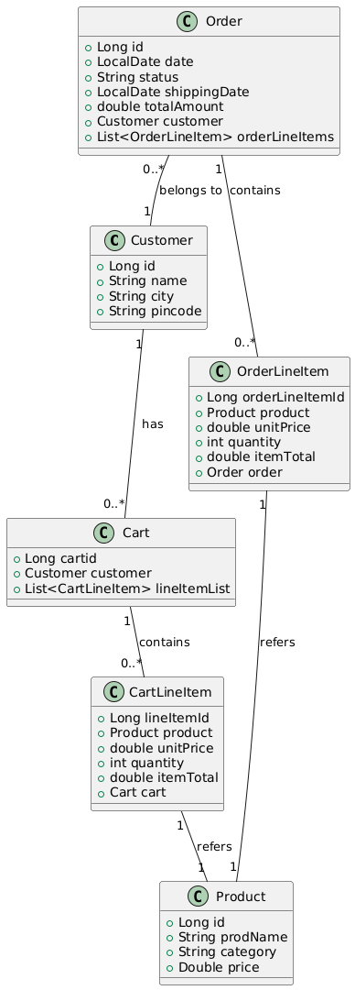
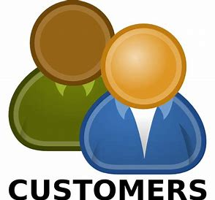
Class diagram
Entity class relations:
Customer Entity:
Represents a user of the online shopping platform.
Each customer can place multiple orders.
Attributes include:
id: Unique identifier for the customer.
name: Name of the customer.
city: City where the customer resides.
pincode: Postal code of the customer's location.

Slide 6
Interactions with one entity to another entity
Customer and cart:
Type of Relationship: One-to-Many (Bidirectional)
Details:
Customer Side: A Customer can have multiple Carts. In your setup, the relationship is unidirectional, meaning Customer does not maintain a reference to Cart.
Cart Side: A Cart belongs to a single Customer. This is represented by the @ManyToOne annotation in the Cart entity.
Cart and LineItem
Type of Relationship: One-to-Many (Bidirectional)
Details:
Cart Side: A Cart can contain multiple LineItems. This is represented by the @OneToMany annotation in the Cart entity.
LineItem Side: A LineItem belongs to a single Cart. This is represented by the @ManyToOne annotation in the LineItem entity.
LineItem and Product
Type of Relationship: Many-to-One (Unidirectional)
Details:
LineItem Side: A LineItem is associated with one Product.
Product Side: There is no reference to LineItem in Product, making this relationship unidirectional.
Customer and Order
Type of Relationship: One-to-Many (Unidirectional from Order to Customer)
Details:
Customer Side: No reference to Order, making this a unidirectional relationship.
Order Side: An Order is placed by a single Customer

Slide 7
Interactions with one entity to another entity
Order and OrderLineItem
Type of Relationship: One-to-Many (Bidirectional)
Details:
Order Side: An Order contains multiple OrderLineItems. This is represented by the @OneToMany annotation in the Order entity.
OrderLineItem Side: An OrderLineItem belongs to a single Order. This is represented by the @ManyToOne annotation in the OrderLineItem entity.
OrderLineItem and Product
Type of Relationship: Many-to-One (Unidirectional)
Details:
OrderLineItem Side: Each OrderLineItem is associated with one Product.
Product Side: There is no reference to OrderLineItem in Product, making this relationship unidirectional.
Bidirectional Relationships:
Cart ↔ LineItem
Order ↔ OrderLineItem
Cart → Customer
Unidirectional Relationships:
Customer → Order
OrderLineItem → Product
LineItem → Product

Slide 8
Class diagram
Entity class relations:
Product Entity:
Represents a product available for purchase on the platform.
Attributes include:
id: Unique identifier for the product.
ProdName: Name of the product.
category: Category under which the product falls.
price: Price of the product.
Relationship:
Many-to-One with CartLineItem: A product can be associated with many line items in different carts.
Many-to-One with OrderLineItem: A product can be part of many line items in different orders.

Slide 9
Class diagram
Entity class relations:
Cart Entity:
Represents a shopping cart where a customer can add products they intend to purchase.
Attributes include:
cartid: Unique identifier for the cart.
Relationship:
Many-to-One with Customer: A cart is associated with one customer.
One-to-Many with CartLineItem: A cart can contain multiple line items, each representing a product added to the cart.

Slide 10
Class diagram
Entity class relations:
CartLineItemEntity:
Represents a shopping cart where a customer can add products they intend to purchase.
Attributes include:
cartid: Unique identifier for the cart.
Relationship:
Many-to-One with Customer: A cart is associated with one customer.
One-to-Many with CartLineItem: A cart can contain multiple line items, each representing a product added to the cart.

Slide 11
Class diagram
Entity class relations:
OrderLineItem Entity:
Represents an item in an order, including details of the product purchased.
Attributes include:
orderLineItemId: Unique identifier for the order line item.
product: The product purchased.
unitPrice: Price of a single unit of the product.
quantity: Quantity of the product purchased.
itemTotal: Total price for this line item (unit price multiplied by quantity).
Relationship:
Many-to-One with Order: A line item is associated with one order.
Many-to-One with Product: A line item is associated with one product.

Slide 12
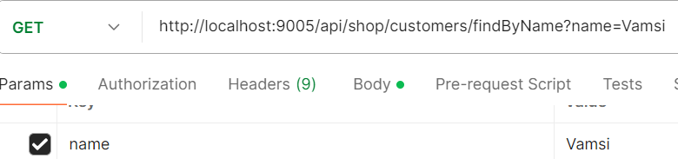

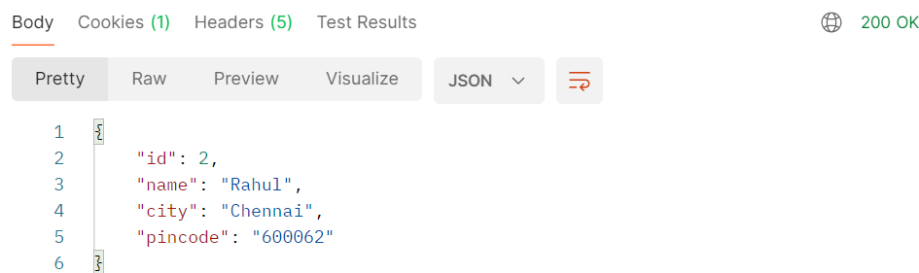
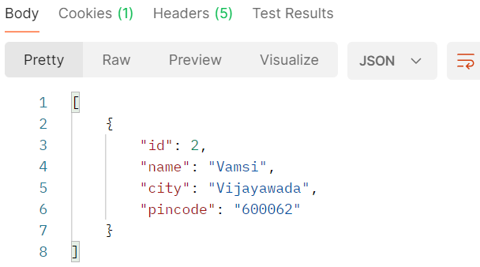
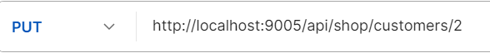
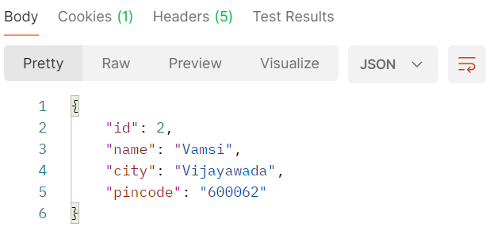
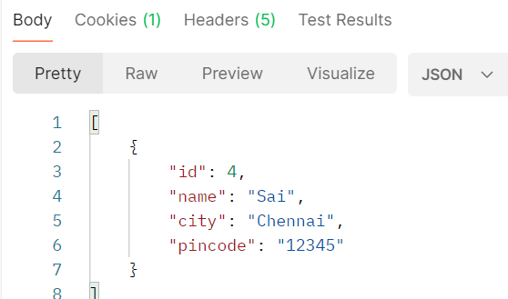
Requirements:
Customer Registration and Management:
Customers can register with their details (name, city, pincode) to create an account.
Customers can view and manage their profile.

Slide 13

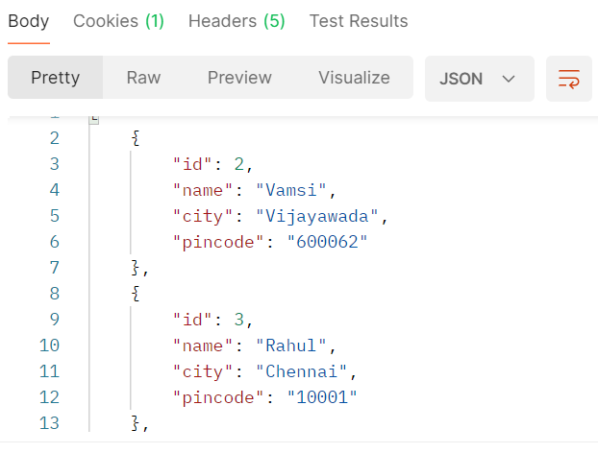
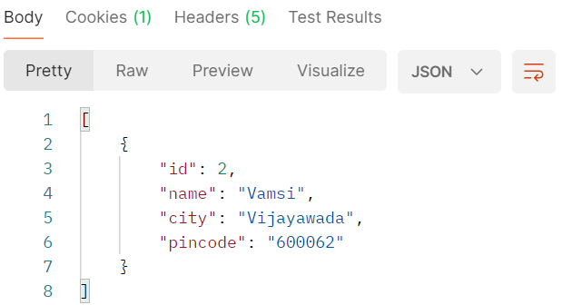
Requirements:
Customer Registration and Management:
Customers can register with their details (name, city, pincode) to create an account.
Customers can view and manage their profile.

Slide 14
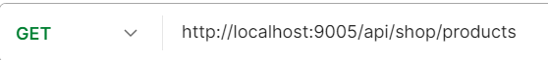
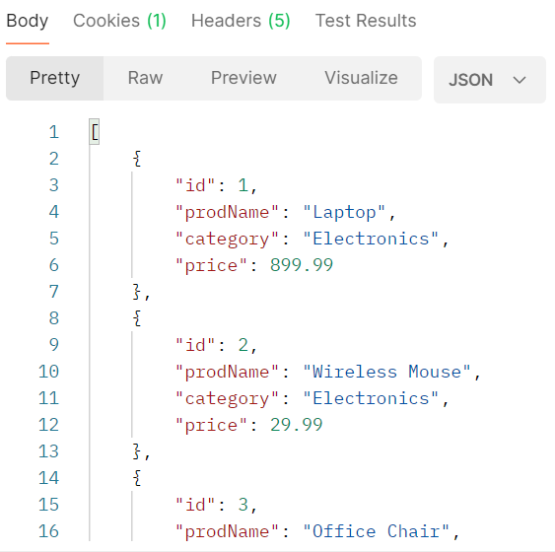

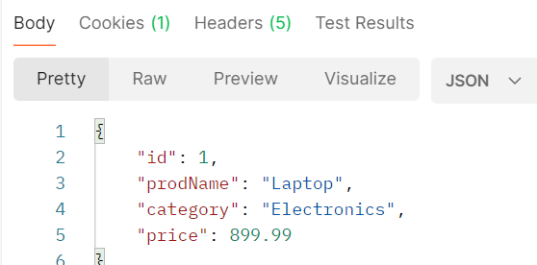
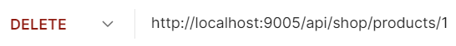
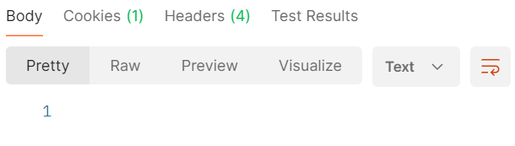
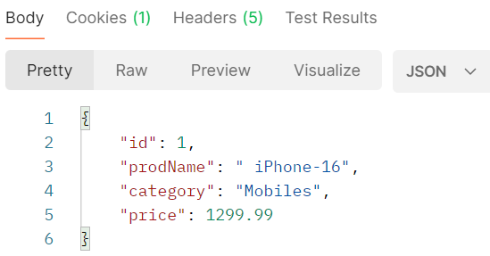
Requirements:
Product Browsing:
Customers can view a list of available products.
Products can be searched by name, category, or price range.

Slide 15
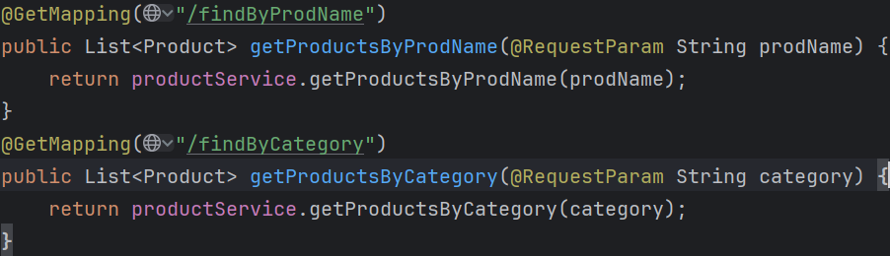
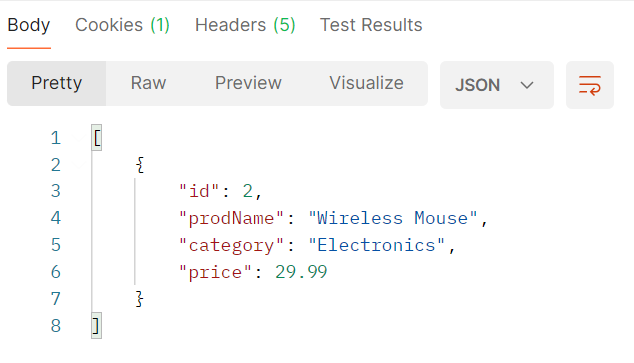
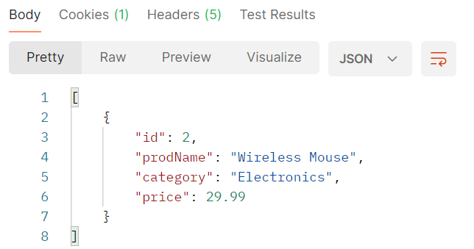

Requirements:
Product Browsing:
Finding by Product name:
Finding by Product category:

Slide 16
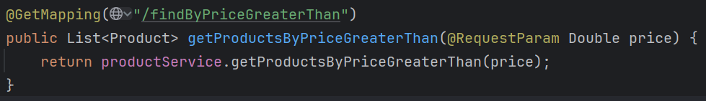
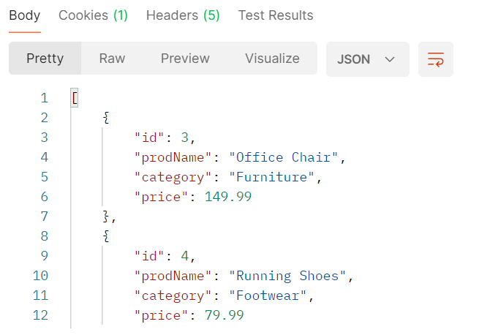
Requirements:
Product Browsing:
Finding the product by price:

Slide 17
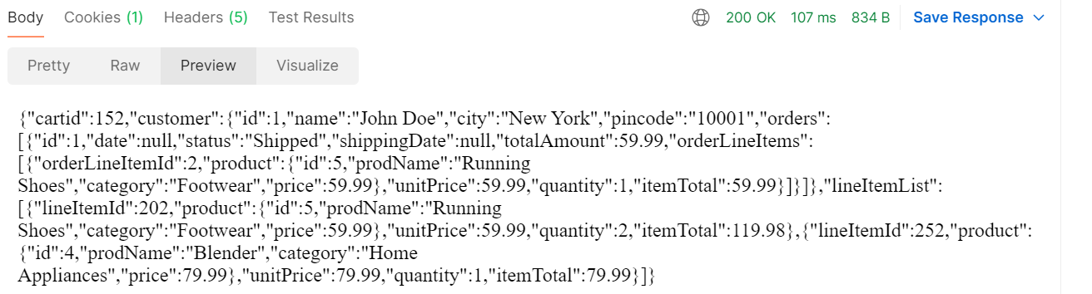
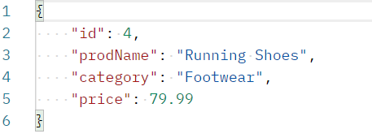
Shopping Cart Management:
Customers can add products to their shopping cart.
The cart can contain multiple items, each represented by a CartLineItem.
Customers can update the quantity of products in their cart or remove items.
The total amount of the cart is calculated based on the items and their quantities.
Cart for customer with id 1
Adding product to the cart with the customer id
Showing the cart with line items of products
Request body with the product details:

Slide 18
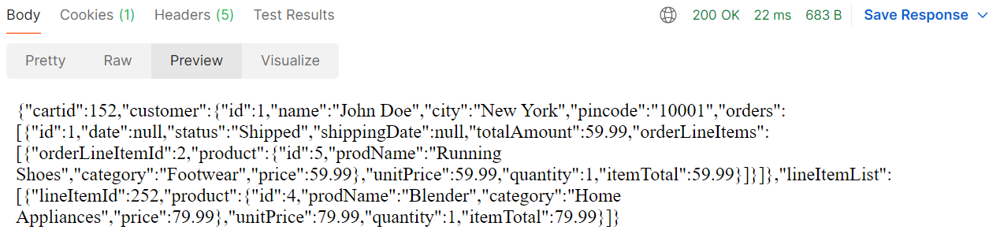
Shopping Cart Management:
Deleting the product from the cart :
The cart from removing an product:

Slide 19
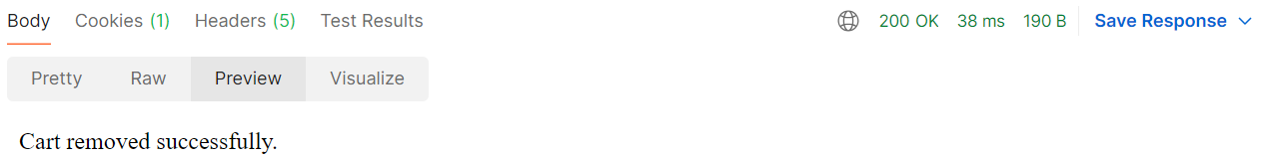
Shopping Cart Management:
Removing / clearing the cart with customer id

Slide 20
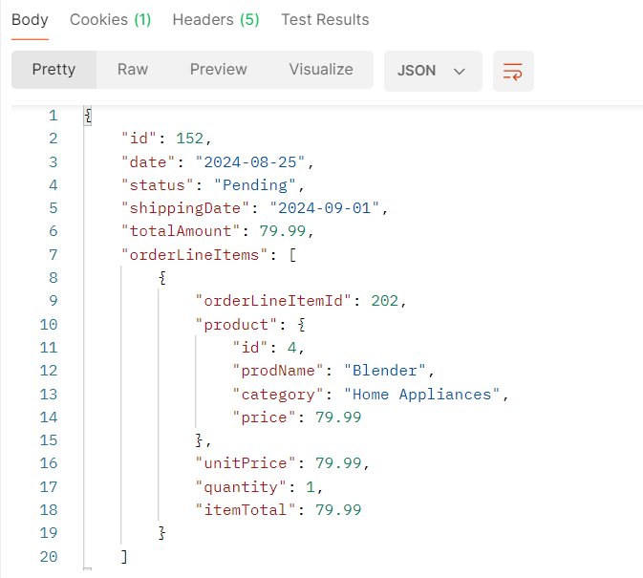
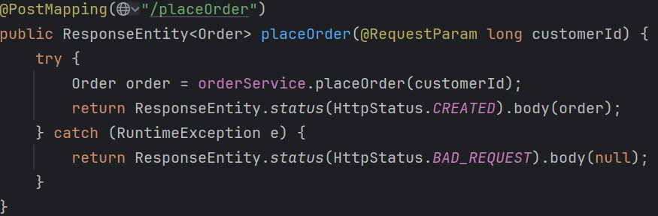
Order Placement:
Placing / conforming an order from cart with customer id :

Slide 21
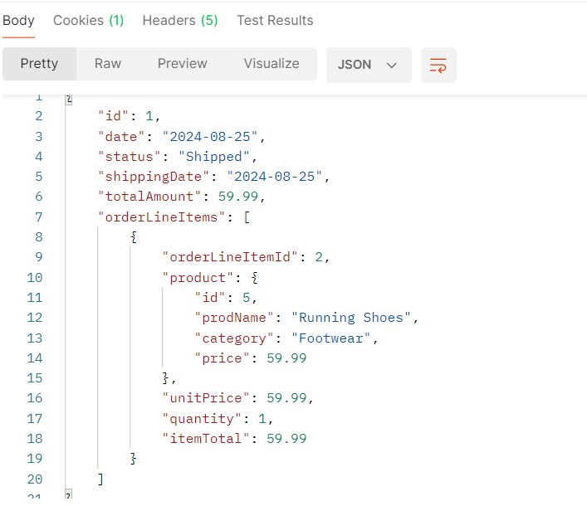
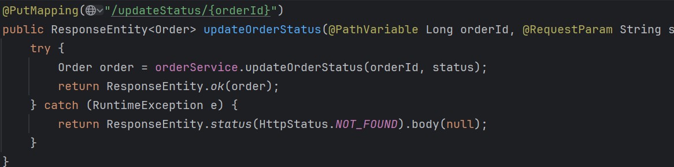
Order Placement:
Updating the status an order from cart with customer id :

Slide 22
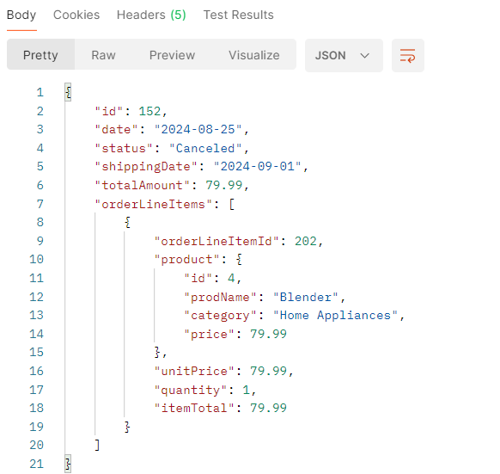
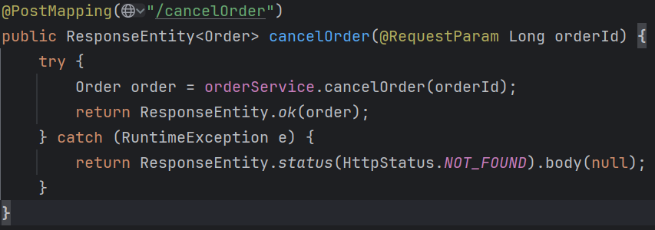
Order Placement:
Canceling the order by customer by order Id:

Slide 23
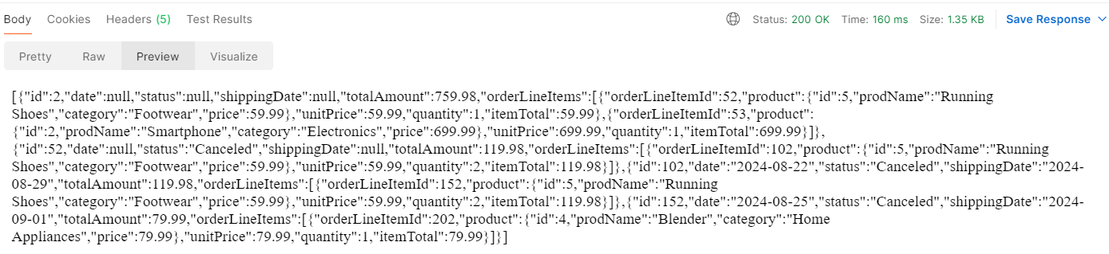
Order Placement:
Viewing all order details :

Slide 24
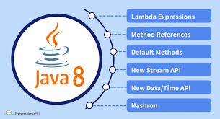
Java 8 Key Features
What is Java 8?
Java 8 introduced significant improvements to the Java programming language, adding new functionality to make code more concise and easier to understand.
Lambda Expressions
Introduces a new way to write anonymous functions with a concise syntax, allowing you to treat functionality as a method argument or to create more readable and flexible APIs.
Use Case: Commonly used in scenarios like sorting collections, iterating through lists, or any functional interface implementation.
Syntax: (parameters) -> expression
Streams API:
Provides a powerful abstraction to work with sequences of elements in a functional style. It allows operations like filtering, mapping, and reducing data, facilitating parallel processing.
Use Case: Often utilized for processing collections of objects, such as filtering a list of users based on criteria, or transforming data into another form. Supports operations like filter, map, reduce, etc.
Optional Class
Helps in avoiding Null PointerException.
Use Case: Typically used in APIs to signal that a method might not always return a value.
Used to represent a value that may or may not be present.

Slide 25
Java 8 Key Features
Default and Static Methods in Interfaces
Allows the addition of methods with a body in interfaces.
Default methods can be overridden, static methods cannot.
Use Case: Allows interfaces to have method implementations without breaking the classes that implement them.
New Date and Time API:
A comprehensive API for handling date and time, introduced to overcome the drawbacks of the existing java.util.Date and Calendar classes. It provides immutable classes and better handling of time zones.
Use Case: Used for precise and clear handling of date and time in applications, such as scheduling tasks or managing timestamps.Replaces the old java.util.Date and java.util.Calendar
Functional Interfaces
An interface with a single abstract method.
Used as a target for lambda expressions and method references.
Use Case: Widely used in functional programming capabilities, such as with Runnable, Callable, and custom interfaces for lambda expressions.
Collectors:
A utility in the Stream API that provides mechanisms for gathering the elements of a stream into a single result, such as a list, set, map, or a concatenated string. The Collectors class contains various static methods for these operations.
Use Case: Used in combination with the Stream API to perform reduction operations, such as summing, joining elements.

Slide 26

Hibernate Overview
Hibernate is an open-source Object-Relational Mapping (ORM) framework for Java applications. It simplifies database interactions by mapping Java objects to relational database tables, eliminating the need for manual SQL queries.
Object-Relational Mapping: Hibernate automatically maps Java classes to database tables and their properties to columns.
Persistence: Handles the persistence of objects to the database, including saving, updating, deleting, and retrieving data.
Querying: Provides a powerful query language called Hibernate Query Language (HQL) for querying data.
Caching: Optimizes performance by caching frequently accessed data.
Transactions: Manages database transactions for data integrity and consistency.
Lazy Loading: Deferring the loading of associated objects until they are actually needed.
How Hibernate Works:
Configuration: Specify database connection details, dialect, and mapping information in a configuration file.
Session Factory: Creates a session factory, which is responsible for creating sessions.
Session: Represents a single unit of work with the database. It is used to perform operations like saving, updating, and retrieving objects.
Transaction: Encapsulates a sequence of database operations that must be executed as a single unit.
Querying: Use HQL or Criteria API to construct queries and retrieve data.
Benefits of Using Hibernate:
Scalability: Handles large datasets and high-traffic applications.
Flexibility: Supports various mapping strategies and querying options.

Slide 27

Spring Overview
Spring is a comprehensive collection of project's ,each designed to simplify and accelerate the development of Java-based enterprise applications. Examples include:
Spring Framework: The core framework for dependency injection, aspect-oriented programming, and more.
Spring Data: Simplifies data access and manipulation.
Spring Security: Provides robust authentication and authorization mechanisms.
Benefits of Spring
Inversion of Control (IoC):
Promotes loose coupling and easier maintenance by shifting the responsibility of managing object dependencies from the application code to the Spring container.
Dependency Injection (DI):
Injects required dependencies automatically, enabling a clean separation of concerns.
Aspect-Oriented Programming (AOP):
Allows for the modularization of cross-cutting concerns, such as logging, security, and transaction management, leading to cleaner and more maintainable code.
Stereotype Annotations
These annotations define the roles and behavior of Spring-managed components:
@Component: Generic stereotype for any Spring-managed component.
@Repository: Indicates that the class provides the mechanism for storage, retrieval, update, delete operations on objects.
@Service: Denotes that the class holds business logic .
@Controller: Marks the class as a Spring MVC controller.
@Autowired: Automatically injects the dependency.
@Scope: Defines the scope of the bean.
@Qualifier: Used to differentiate between beans when multiple beans of the same type exist.

Slide 28
Spring Overview
Spring MVC - Model View Controller
Spring MVC is a web framework built on the Model-View-Controller design pattern. It simplifies the development of web applications by organizing them into three main components:
Model: Represents the data and business logic of the application.
View: Represents the presentation layer, which is typically rendered as HTML.
Controller: Handles user requests and maps them to the appropriate model and view.
Front Controller Pattern : A centralized controller, Dispatcher Servlet, is used to handle all web requests. It delegates the requests to various handlers based on configurations.
Key Components:​
View Resolver: Resolves the view name to a specific view.​
Handler Mapping: Maps web requests to handler methods.​
View: The interface for rendering the view.​
Controller: The interface to handle requests.​
Handler Adapter: Adapts handler methods for Dispatcher Servlet.​
Attributes of @RequestMapping:​
Value: Specifies the URL pattern for the method.​
Method: Defines the HTTP methods (GET, POST, PUT, DELETE) the method will handle.​

Slide 29
Spring Overview
Spring Data JPA
Description: Spring Data JPA simplifies data access by automating the implementation of the data access layer. It provides built-in implementations of common operations and supports the use of custom queries.
Main Interfaces:
JpaRepository: Offers CRUD operations and additional JPA-related methods.
PlatformTransactionManager: Integrates various transaction management APIs, such as:
DataSourceTransactionManager
HibernateTransactionManager
JpaTransactionManager
Spring Security​
Description: Spring Security is a powerful framework that provides comprehensive security services for Java applications. It handles authentication, authorization, and other security-related tasks.​
Key Concepts:​
Authentication: The process of verifying credentials.​
Authorization: Determining access rights based on roles and permissions.​
Authentication Provider: A component responsible for authenticating users.​
Password Encoder: To secure passwords, Spring Security allows for the encryption of passwords using a specified algorithm.​
​

Slide 30
Spring Boot Overview
Spring Boot is an extension of the Spring Framework that simplifies the development of stand-alone, production-grade Spring applications. It eliminates the need for extensive configuration, enabling developers to start building applications with minimal setup.
Key Features:
Auto-Configuration: Automatically configures Spring applications based on the jar dependencies you have added.
Standalone Applications: Allows for the creation of applications that can run independently without requiring an external servlet container.
Production-Ready Features: Includes embedded servers like Tomcat or Jetty, metrics, health checks, and externalized configuration.
Spring Boot Actuator
Description: Spring Boot Actuator provides production-ready features to help you monitor and manage your application. It includes endpoints to expose information about the running application, such as health status, metrics, environment properties, and more.
Key Endpoints:
/actuator/health: Shows application health information.
/actuator/metrics: Displays metrics information for the current application.
/actuator/env: Exposes properties from the Spring Environment.

Slide 31
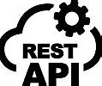
REST API Overview
Representational State Transfer (REST) is an architectural style that uses HTTP requests to access and manipulate data. RESTful APIs allow communication between client and server in a stateless manner, typically using JSON or XML as the data format.
Key HTTP Methods:
GET: Retrieve data from the server.
POST: Create a new resource on the server.
PUT: Update an existing resource on the server.
DELETE: Remove a resource from the server.
Building a REST API with Spring Boot
Spring Boot simplifies the process of building RESTful web services by providing a robust and flexible framework.
Key Components:
@RestController: A specialized version of @Controller that combines @Controller and @ResponseBody. It is used to create RESTful web services.
@RequestMapping: Used to map web requests to specific handler methods based on HTTP methods and URL patterns.
@PathVariable: Binds a method parameter to a URI template variable.
@RequestBody: Binds the HTTP request body to a method parameter.
Security in REST APIs
Description: Spring Security can be integrated into Spring Boot applications to secure REST endpoints.
Basic Authentication: Requires username and password for each HTTP request.
OAuth2/JWT: For more complex scenarios involving token-based authentication.

Slide 32
Conclusion
In summary, our online shopping system offers a streamlined and integrated solution that connects `Customer`, `Cart`, `Order`, and `Product` entities to deliver an efficient e-commerce experience. By enabling customers to manage their cart, place and track orders, and interact with a dynamic product catalog, the system ensures a user-friendly shopping journey. Leveraging Java Spring Boot and JPA/Hibernate, the platform is built for scalability and future enhancements, including advanced features and improved user experiences.

Slide 33
Thank You

